Slide 1

Consumer Insights & Big Data
Descriptive Statistics with IBM Statistics
Yann Gouedo
Data Scientist Leader – Machine Learning / Artificial Intelligence
Marketing / Risk / Fraud / Maintenance
IBM Certified Senior Data Scientist & IBM Certified Senior Architect

Slide 2
50 Years of SPSS Innovation
1968
SPSS first release
1983
SPSS^{X} (v10) released
1992
SPSS for Windows
2008
SPSS Statistics v16 Java UI
2017
SPSS Statistics Subscription
1960’s
1970’s
1980’s
1990’s
2000’s
2010’s
1975
SPSS Inc. established
1998
ISL Clementine joined SPSS as Modeler
2009
PASW Statistics prior to IBM acquisition . Later become SPSS Statistics
2018
New UI, again.
Notes:
The IBM SPSS Predictive Analytics portfolio consists of the following products:
IBM SPSS Statistics. This is used for ad-hoc statistical analysis and reporting -- one of the most popular commercial products for Statistics in the market today
IBM SPSS Modeler for building powerful predictive models
All products will be covered in more detail in the subsequent slides.

Slide 3
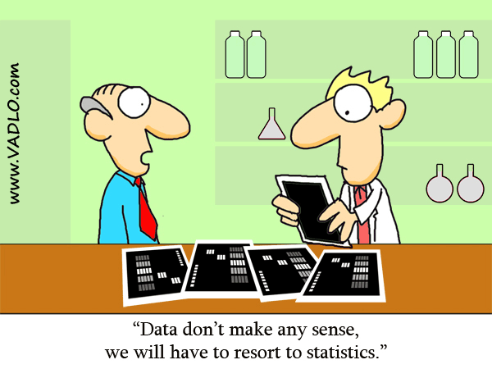
What is IBM SPSS Statistics?
Ad-hoc analysis, hypothesis testing, and predictive analytics
Organizations use it to:
Understand data
Analyze trends
Forecast and plan
Notes:
Les données n'ont aucun sens Nous devrons recourir aux statistiques

Slide 4


Statistical Analysis & Data Mining: Feeding Predictive Analytics
Top-Down Approach
Bottom-up Approach
A statistical approach involves
forming a theory about a possible relationship
converting it to a hypothesis
testing that hypothesis using statistical methods
It is a manual, user-driven, top-down approach to data analysis
Data mining involves the interrogation of the data and is performed by the data mining method rather than by the user
It is a data-driven, self-organizing, bottom-up approach to data analysis that works on very large data sets
Source: DM Review
“Statistical Modeling: The Two Cultures,” Leo Breiman, Statistical Science, 2001, Vol.16 (3), pp.199-231.
Note that Both Approaches can Drive Predictive Analytics
Notes:
Statistical Analysis & Data Mining are both key ingredients of Predictive Analytics. In the SPSS portfolio SPSS Statistics is mainly used for statistical analysis and statistical hypothesis testing and SPSS Modeler is mainly used for data mining. The products are not mutually exclusive but reinforce each other.

Slide 5
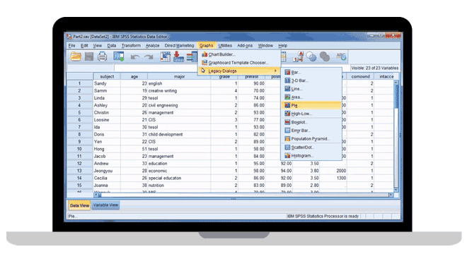
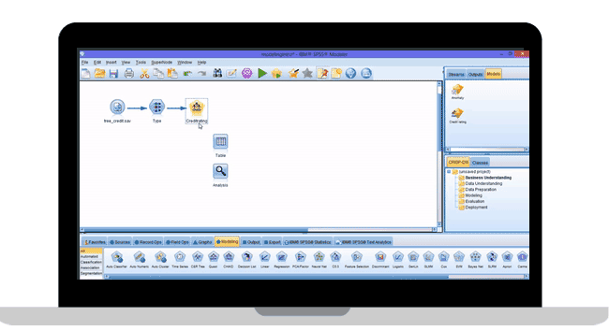
IBM Statistics Platform and SPSS Data Science
IBM SPSS Statistics
The world’s leading statistical software used to solve such business and research problems by means of ad-hoc analysis and hypothesis testing
IBM SPSS Modeler
A predictive analytics platform that brings predictive intelligence to decisions made by individuals, groups, systems and the enterprise.
Notes:
The IBM SPSS Predictive Analytics portfolio consists of the following products:
IBM SPSS Statistics. This is used for ad-hoc statistical analysis and reporting -- one of the most popular commercial products for Statistics in the market today
IBM SPSS Modeler for building powerful predictive models
All products will be covered in more detail in the subsequent slides.

Slide 6
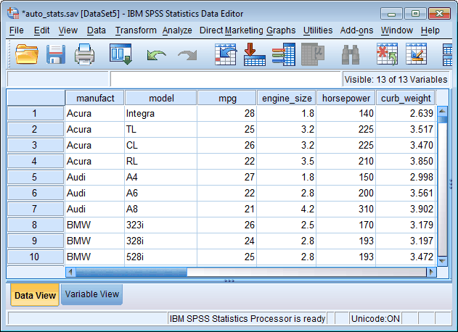
IBM SPSS Statistics
OVERVIEW
Quickly understand large and complex datasets using advanced statistical procedures ensuring high accuracy to drive quality decision-making
IBM SPSS Statistics is the world’s leading statistical software which has been around for 40+ years
CUSTOMER NEEDS
We help people validate (or disprove!) assumptions faster and efficiently using the right statistical capability, at the right time.
Organizations use IBM SPSS Statistics to understand data, analyze trends, forecast and plan so they can validate assumptions and drive accurate conclusions.
TARGET AUDIENCE
Analytic Professional/ Researcher
Business Analyst
CUSTOMER EXAMPLES
Meteolytix GmbH builds statistical models that provide daily sales forecasts for the retail and service sectors.
Bank Alfalah Pakistan - improves the efficiency of credit application processing
WHY IBM ?
The world’s leading statistical software which has been around for 40+ years
Menu-driven experience for the beginner
Command syntax and programmable extensibility for the experienced statistician
access to external programming (R, Python, Java, .Net)
Flexible deployment from stand-alone to enterprise support
Notes:
Overview
IBM SPSS Statistics
Organizations have a core need to understand data and the statistical analyses applied to that data, and to quickly and accurately analyze and interpret data to drive decision-making. In a variety of industries and applications, there is a need to confirm (or deny) the existence of trends in data. IBM SPSS Statistics is the world’s leading statistical software used to solve such business and research problems by means of ad-hoc analysis, hypothesis testing and predictive analytics. Organizations use IBM SPSS Statistics to
Begin an analytical journey – IBM SPSS Statistics Base
Understand data and analyze trends – IBM SPSS Statistics Standard
Forecast and plan to validate assumptions – IBM SPSS Statistics Professional and Premium
To know more about individual modules and its benefits, click on the assets tab.
For more than 40 years, IBM SPSS Statistics has helped organizations of all types to increase revenue, outmaneuver competitors, conduct research and data driven decision-making.
Benefits/Value proposition
What we do
We help people validate (or disprove!) assumptions faster and efficiently using the right statistical capability, at the right time.
With IBM SPSS Statistics, analysts use a host of analytical power to meet the needs of the most experienced statistician down to the beginner.
We help organizations use their analytical resources to the fullest extent, scaling from the simplest initiative to the most widespread effort.
How it does it
IBM SPSS Statistics products provide the most comprehensive set of tools for the entire analysis lifecycle, customizable with multiple data types and add-on modules to give people what they need.
Access key functions through multiple interfaces: a command syntax or programmable extensibility for the experienced statistician and a menu-driven experience for the beginner.
IBM SPSS Statistics does this with multiple deployment options – from a stand-alone desktop application ideal for individuals, to a multiclient/server deployment appropriate for larger analyst teams. Since IBM SPSS Statistics works with all other IBM SPSS Portfolio Offerings, it can become an important foundation for building a predictive enterprise.
Average Deal Size/Pricing
USD 4K–10K
Target Audience
Analytic Professional
IBM SPSS Statistics’ typical user
Process oriented – more likely to write syntax and discuss routine statistical procedures
Focused on setting up analyses from beginning to end (methodology)
Primary concern – accuracy
Deep diver – often trained in a specific area of analysis
Hard-core analyst or researcher – an oncologist researcher at the Mayo Clinic
A technical understanding of data
Really smart, in a technical way
Business Analyst
Proficient with Excel – likely knows how to use more advanced functionalities (lookup tables, complex formulas)
Outcome oriented – more likely to discuss business problems and solutions
Focused on getting it done, even if the approach is not “perfect”
Primary concern – quick
“Jack of all trades” – often trained in cross-functional, ad-hoc type analysis
Approaches analytics with a defined business task in mind – a market analyst studying campaign responses
A business understanding of data
Really smart, in a strategic way
Competitive Differentiators
Multiple interfaces to robust and sophisticated functionality and procedures that address the entire analysis lifecycle and provide broad access to multiple data types:
Menu-driven experience for the beginner
Command syntax and programmable extensibility for the experienced statistician
Open interface for access to external programming languages, such as Python, R, .NET and Java® for the inclusion of additional functionality and procedures
Flexible deployment options–from a stand-alone desktop application ideal for individuals, to a multi-client/server deployment appropriate for larger analyst teams.

Slide 7
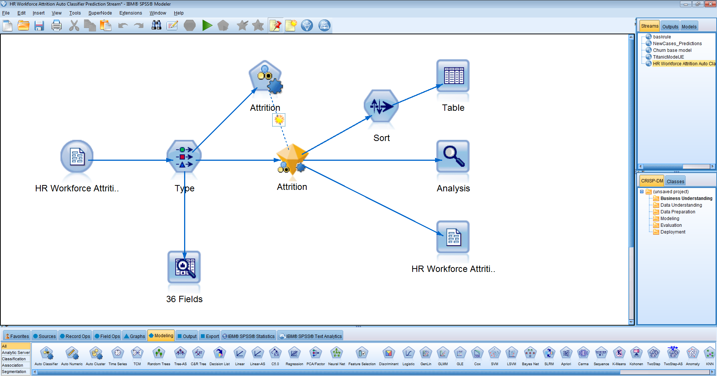
IBM SPSS Modeler
OVERVIEW
Comprehensive predictive analytics workbench
Easy-to-use, interactive interface without the need for programming
Automated modeling and data preparation capabilities
Access ALL data – structured and unstructured – from disparate sources
Providing a range of advanced analytics - text analytics, entity analytics, social network analysis, etc.
CUSTOMER NEEDS
Improve business outcomes through predictive intelligence
Deploy predictive models in operational processes to take better decisions at the point of impact
TARGET AUDIENCE
Technical Data Scientist
Citizen Data Scientist
Business Analyst
CUSTOMER EXAMPLES
AB Volvo in Sweden reduces truck diagnostic time by up to 70 percent.
Autobacs Seven Co. in Japan conducts more targeted promotional campaigns, increasing its conversion rates by more than 20 percent
WHY IBM ?
Simplicity without sacrifice
Code optional, open to open source (R, Python, SPARK)
Deployment at scale
Notes:
BM SPSS® Modeler is a comprehensive predictive analytics platform, designed to bring predictive intelligence to everyday business problems, enabling front-line employees or systems to make more effective decisions and improve outcomes. Modeler scales from desktop installations through to larger deployments that are integrated within operational systems and provides a range of advanced analytics including text analytics, entity analytics, social network analysis, automated modeling and data preparation in addition to decision management and optimization.
This enables organizations to improve business processes and help people or systems consistently make the right decisions by delivering recommended actions at the point of impact. The result is a rapid return on investment (ROI) and the ability to proactively and repeatedly reduce costs and increase productivity.
Examples of user benefits include identifying which customers are likely to leave (customer attrition), predicting what products and services prospects are likely to purchase together (retail market basket analysis), identifying which claims have a high probability of fraud (insurance), mitigating risk by predicting which robots on the assembly line are likely to fail (predictive maintenance), and deploying police resources based on “hot spots” (predictive policing).
Overview
Within a business environment, the main objective of analytics is to improve a business outcome such as; increasing revenue by reducing customer attrition, increasing cross sell rates through a call center, decreasing costs by identifying fraudulent claims before payment, or servicing a component in a production line to minimize downtime. Analytics can be applied to improve a decision, which in turn will result in a better outcome.
Data mining is the process of uncovering patterns in data using analytical techniques such as descriptive analysis and predictive modeling through to more advanced techniques involving text analytics, entity analytics, decision management and optimization. By identifying patterns and deploying predictive models into operational systems, organizations enable systems and people to consistently make the right decision at the point of impact The result is the ability to maximize outcomes based on the predictive intelligence hidden in data of growing size and complexity.
IBM SPSS Modeler can be adopted and installed on a variety of environments – it can be used as a pure on-premises solution, server products can be hosted to create a hybrid environment, and IBM SPSS Modeler Gold is available in the cloud (Software-as-a-Service [SaaS] model). Consider all options when working with customers and prospects.
Target Audience
Users:
Business Analyst: Business experts and analysts without a statistical or data mining background:
Works as a liaison among stakeholders in order to elicit, analyze, communicate and validate requirements for changes to business processes, policies and information systems
Data Scientist: Professional with a background in statistics or data mining, often a shared resource in his/her organization: An expert that has specialized knowledge and skills in a specific area of analysis
Citizen Data Scientist – has emerged as advanced analytics have become more accessible – these are individuals that are comfortable with data, they understand some but not all advanced techniques, and they are comfortable with statistical concepts and maybe even some predictive modeling as long as its guided and visual
Technical Data Scientists – is a reboot of actuarial science, deep math, statisticians, data miners, game theorists, and econometric specialists. While the code of data science has been around for a while, it has gotten easier to work with (Rstudio), easier to get (open source) and more powerful thanks to the community approach to development embraced by the open source community. These are the new rock stars that are versed in Python, Spark, R – but these individuals need the guidance of the business to be most effective
Buyers:
Business Manager (including Analysis Manager):
Responsible for improving the operations within their department or area of responsibility according to organizational policies and objectives
Stakeholders:
IT:
Responsible for installing, administering and maintaining technology within an organization
Executive:
Responsible for managing the overall operations, strategic and profitability of an organization
Competitive Differentiators
Easy to learn/use:
Visual approach – no programming
Supports documentation and reuse of models and modeling streams
Flexible deployment and licensing options
Power and automation:
Automated data preparation and modeling
Full range of modeling algorithms
Full range of data access and data transformation functions
Multi model creation and evaluation (ensemble models)
Integrated analysis of text, web and survey data
Scalable solution with flexible deployment options:
No need for proprietary databases
SQL pushback
Maximized use of infrastructure with multithreading, clustering and use of in-database data mining procedures
Already fully integrated with additional IBM technology
Can be deployed on-premises, in the cloud or as a hybrid

Slide 8
IBM® SPSS® Statistics ROI IBM® SPSS® Modeler ROI
Descriptive Analytics with IBM® SPSS® Statistics helps statisticians to validate statistical hypotheses by using efficient descriptive methods. IBM® SPSS® Statistics will not predict information but will describe data and validate statistical hypothesis.
Difficult to evaluate financial results of IBM SPSS Statistical because it will not allow statistics results to be integrated to operational IT (call center, campaigns, website…).
Predictive Analytics with IBM® SPSS® Modeler helps connect data to effective action by drawing reliable conclusions about current conditions and future events. Predictive Analytics allows organisation to retain customers, increase customers portfolio, increase Marketing campaign effectiveness, reduce churn rate et fraud….
Some examples of financial results:
35% reduction in mailing cost, 2X response rate, 29% more profit - FTBO
Reduced churn from 19 to 2% - Cablecom
100% increase in campaign effectiveness - BT
30 Million Euro in new revenue - AEGON

Slide 9
End users
Typical IBM® SPSS® Statistics users
Usually have academic training
Need to perform hypothesis tests
Process Oriented – More likely to write Syntax and discuss routine statistical procedures
Focused on setting up analyses from beginning to end (methodology)
Primary concern – utilizing selected algorithm for analysis
Deep Diver – Often trained in a specific area of analysis
Hard-core analyst or researcher
A technical understanding of data
Preferred interface: Spreadsheet
Typical IBM® SPSS® Modeler users
Usually have subject matter expertise such as a business analyst
Need to build models but don’t necessarily understand the analytics
Graphically Oriented – Prefers to use graphical, point and click tools
Focused on uncovering quick, accurate and actionable insights
Primary concern – explore multiple analytical approaches using automated techniques for best results
Data Miner– Extract data from multiple data source, merge and derive new data for analysis
Empower Business User – Deep understanding of business issues and drivers
A business understanding of data
Preferred interface: Graphical Reporting

Slide 10
Editions IBM® SPSS® Statistics
Statistics Standard Bundle
Statistics Premium Bundle
IBM SPSS Statistics Base
IBM SPSS Advanced Statistics
IBM SPSS Custom Tables
IBM SPSS Regression
IBM SPSS Statistics Base
IBM SPSS Advanced Statistics
IBM SPSS Custom Tables
IBM SPSS Regression
IBM SPSS Data Preparation
IBM SPSS Categories
IBM SPSS Decision Trees
IBM SPSS Forecasting
IBM SPSS Bootstrapping
IBM SPSS Conjoint
IBM SPSS Exact Tests
IBM SPSS Neural Networks
IBM SPSS Direct Marketing
IBM Complex Samples
IBM SPSS Viz Designer
IBM SPSS Amos
IBM SPSS SamplePower
Statistics Professional Bundle
IBM SPSS Statistics Base
IBM SPSS Advanced Statistics
IBM SPSS Custom Tables
IBM SPSS Regression
IBM SPSS Data Preparation
IBM SPSS Missing Values
IBM SPSS Categories
IBM SPSS Decision Trees
IBM SPSS Forecasting

Slide 11

IBM SPSS Statistics and the Analytical Process
1. Planning
Deployment 7.
IBM SPSS SamplePower
IBM SPSS Conjoint
IBM SPSS Complex Samples
IBM SPSS Collaboration and
Deployment Services
Reporting 6.
2. Data Collection
IBM SPSS Custom Tables
IBM SPSS Data Collection Data Entry
IBM SPSS Data Collection Interviewer Web
Data Analysis 5.
3. Data Access
IBM SPSS Statistics Base
and Modules
IBM SPSS Modeler
IBM SPSS Missing Values
IBM SPSS Data Preparation
IBM SPSS Text Analytics for Surveys
IBM SPSS Modeler
4.
Data Management
and Preparation
IBM SPSS Statistics Base and Modules
IBM SPSS Modeler
Notes:
This will be talked at a very high level.

Slide 12
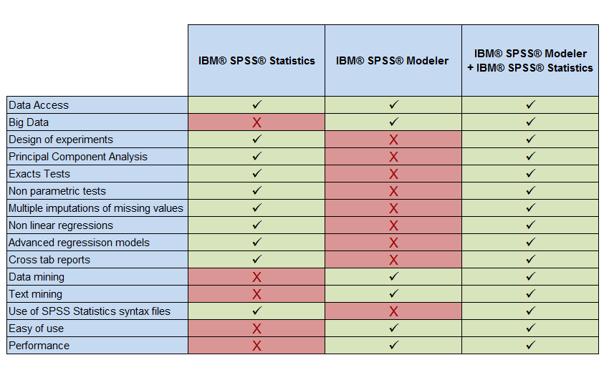
IBM® SPSS® Statistics vs IBM® SPSS® Modeler

Slide 13
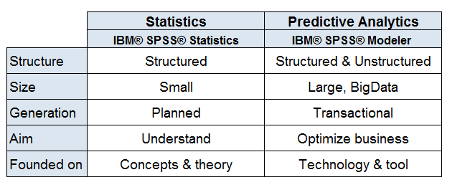
Summary IBM® SPSS® Statistics vs IBM® SPSS® Modeler

Slide 14
Integration IBM® SPSS® Statistics / IBM® SPSS® Modeler
IBM SPSS Statistics is integrated with IBM SPSS Modeler :
There is a dedicated IBM® SPSS® Statistics Palette within IBM® SPSS® Modeler
Allows Statistics models, transformations, output and syntax within the IBM® SPSS® Modeler Graphics User Interface ➔ Statistics + Predictive Analytics in the same box!
Uses IBM® SPSS® Statistics in the background to run analysis from the IBM® SPSS® Modeler interface
Requires an IBM® SPSS® Statistics license for the procedures

Slide 15
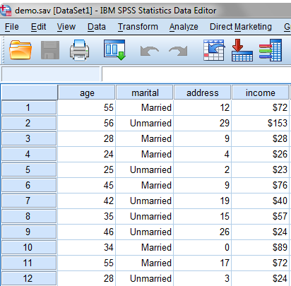
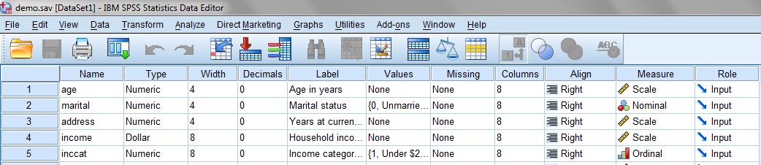
SPSS Interface
Data view vs. Variable view
Variable and value labels
Variable types and measures

Slide 16
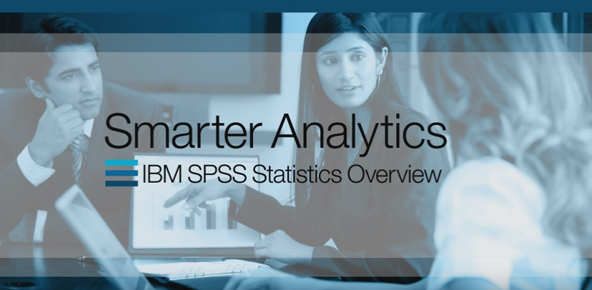
IBM® SPSS® Statistics Video
https://www.youtube.com/watch?v=SWdEtsMvSnM

Slide 17
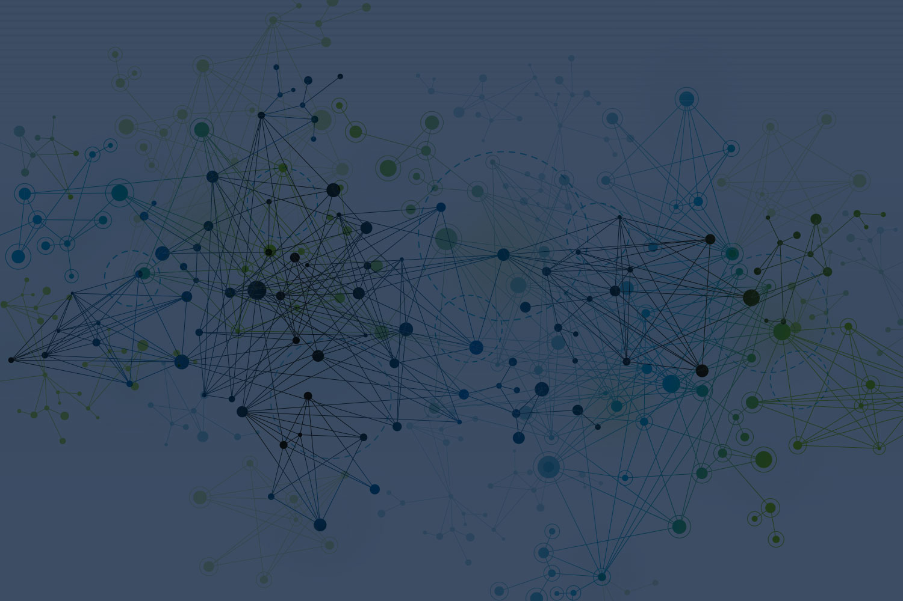
IBM Statistics Standard

Slide 18
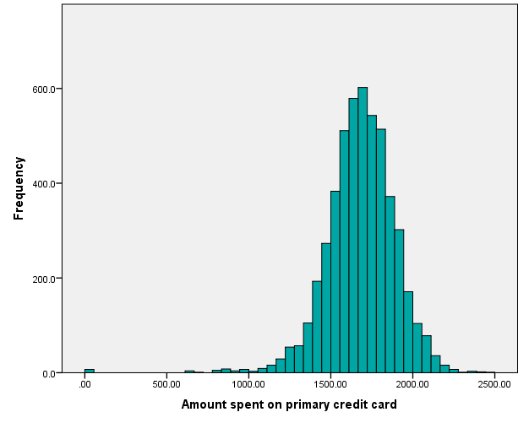
IBM® SPSS® Statistics Base
What is it?
Statistical and data management package for analysts and researchers
When is it needed?
When working through data access, data management, data preparation, preparation, analysis and reporting
What it address?
Ability to generate decision making information quickly using statistics
https://www.youtube.com/watch?v=OzAlvH8PbtI

Slide 19
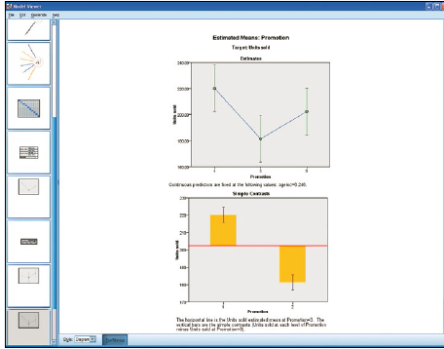
IBM® SPSS® Statistics Advanced Statistics
What is it?
Helps you analyze complex relationships with sophisticated procedures
When is it needed?
When working with data that has unique characteristics, such as nested-structure data or data with a covariance structure
If you need to go beyond basic analysis and require extensive modeling flexibility
What’s in it?
Generalized Linear Models
Generalized Estimating Equations
General linear models
Linear mixed models
Generalized linear Mixed Models for
Ordinal Targets
Variance component estimation
Survival analysis
Loglinear analysis
Generalized Linear Mixed Models
Combination of Generalized Linear and Linear Mixed Models
https://www.youtube.com/watch?v=8YXs7mioo18

Slide 20
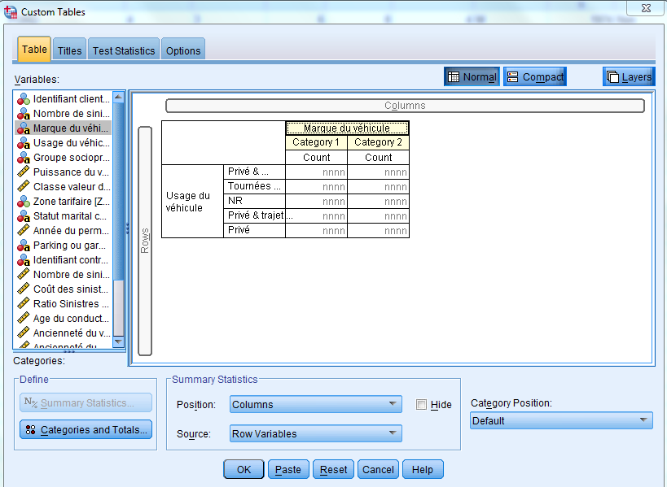
IBM® SPSS® Statistics Custom Tables
What is it?
A reporting module that produces high-quality tabular reports
When is it needed?
When needing to summarize your results so they are easily understood and meaningful to a large audience
What’s in it?
Table preview builder
Flexible table types
Controlled output during
table creation
Inferential statistics
Powerful syntax
https://www.youtube.com/watch?v=0GBulmBkYvU

Slide 21
IBM® SPSS® Statistics Regression
What is it?
Helps you achieve more modeling control and power with logistic regression, nonlinear regression and other advanced modeling tools
When is it needed?
When needing advanced predictive capabilities
When working with categorical data
If building predictive models but Ordinary Least Squares Regression is too limiting
What’s in it?
Multinomial logistic regression
Binary logistic regression
Unconstrained nonlinear regression
Constrained nonlinear regression
Weighted least squares
Two-stage least squares
PROBIT
https://www.youtube.com/watch?v=Fyz-tFXjNRg

Slide 22
IBM Statistics PROFESSIONAL

Slide 23
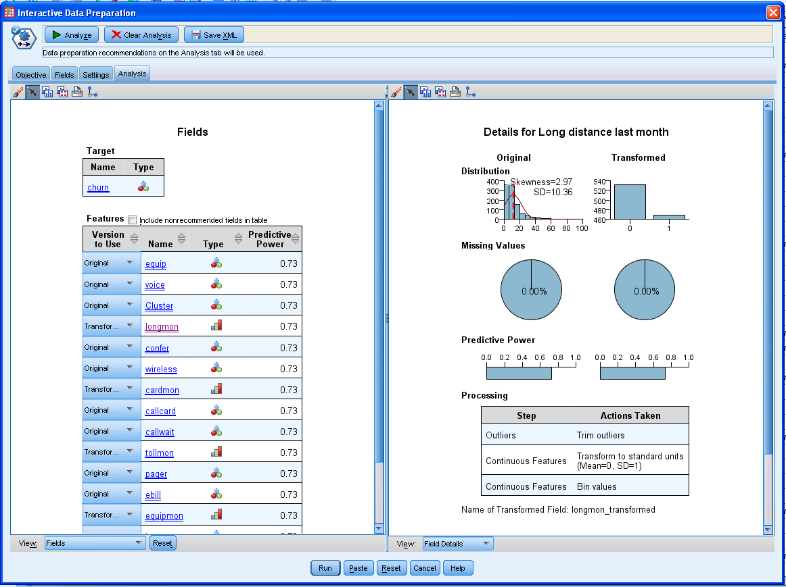
IBM® SPSS® Statistics Data Preparation
What is it?
Get data ready for subsequent analyses
When is it needed?
To streamline the data validation process, eliminate labor-intensive manual checks and reach more accurate conclusions
What’s in it?
Streamline the process of validating
data before analyzing it
Anomaly detection to identify unusual
cases in a multivariate setting
Optimal cut-points to categorize
continuous predictors
Automated Data Preparation
https://www.youtube.com/watch?v=jMWb2AMC31s

Slide 24
IBM® SPSS® Statistics Missing Values
What is it?
Helps you overcome missing data problems, resulting in better models and more usable data sets
When is it needed?
Whenever your data set contains missing data – questions without answers or variables without observations
What’s in it?
Pattern analysis and reporting
Summary statistics
Missing value estimation algorithms
Data management
Multiple imputation
https://www.youtube.com/watch?v=nnEZymh05Ng

Slide 25
IBM® SPSS® Statistics Categories
What is it?
Enables you to understand groupings in your data and predict key outcomes
When is it needed?
When analyzing categorical data, such as market segments, political parties or biological species or continuous data where you want to use some advanced regression techniques such as flexible functional forms or regularization techniques such as ridge regression, lasso, or elastic net.
What’s in it?
Multi-Dimensional Scaling of Proximity Data
Principal Components Analysis
Correspondence Analysis
Categorical Regression Analysis via optimal scaling
Homogeneity Analysis via alternating least squares (also known as Multiple Correspondence Analysis)
Canonical Correlation Analysis of two or more sets of variables via alternating least squares
https://www.youtube.com/watch?v=r4ZTaDoeZgE

Slide 26
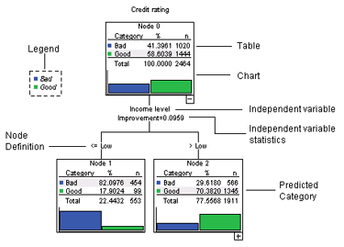
IBM® SPSS® Statistics Decision Trees
What is it?
Help you better identify groups, discover relationships between groups, and predict future events
When is it needed?
When working with data that has complicated, non-linear relationships
Discover relationships that classical statistical techniques might not find
What’s in it?
CHAID
Exhaustive CHAID
CR&T
QUEST
https://www.youtube.com/watch?v=I-LBKbbJTDM

Slide 27
IBM® SPSS® Statistics Forecasting
What is it?
Helps you predict the future with powerful time-series analysis
When is it needed?
If you need to analyze historical information, forecast future trends, or predict events
When seasonality is a consideration in your forecasting
What’s in it?
Box-Jenkins analysis
Procedures for seasonal factors
Expert Modeler
Estimate up to four parameters in 12 different models for exponential smoothing
Trend regressions
Regression models with first-order autoregressive errors
Decompose a time series into its harmonic components
https://www.youtube.com/watch?v=q_U_Lh5Byr4

Slide 28
IBM Statistics PREMIUM

Slide 29
IBM® SPSS® Statistics Bootstrapping
What is it?
Enables you to assess the stability of your statistics so you can be confident in their reliability
When is it needed?
When dealing with smaller samples or when you have outliers in your sample
What’s in it?
Framework to bootstrap a variety of statistical algorithms:
Estimates the sampling distribution of an estimator by re-sampling with replacement.
Derives estimates of standard errors and confidence intervals of a population parameter like a mean, median, proportion, odds ratio, correlation coefficient or regression coefficient.
https://www.youtube.com/watch?v=16myQbWsUdk

Slide 30
IBM® SPSS® Statistics Conjoint
What is it?
Helps you measure how individual product attributes affect consumer preferences
When is it needed?
When developing new products, to help determine the most important features and attributes to your customers
What’s in it?
Orthoplan
Plancards
Conjoint
https://www.youtube.com/watch?v=PjWQIrv7Jpc

Slide 31
IBM® SPSS® Statistics Exact Tests
What is it?
A resource when data is limited and collecting more is not an option
When is it needed?
When investigating relationships among categorical variables or using nonparametric analysis techniques, and have a limited amount of data
What’s in it?
Over 30 exact testing methods for nonparametric and categorical data problems:
One-sample, two-sample and K-sample tests
Independent or related samples
Goodness-of-fit tests, tests of independence in crosstabulations and on measures of association
https://www.youtube.com/watch?v=_hPhI8pofT0

Slide 32
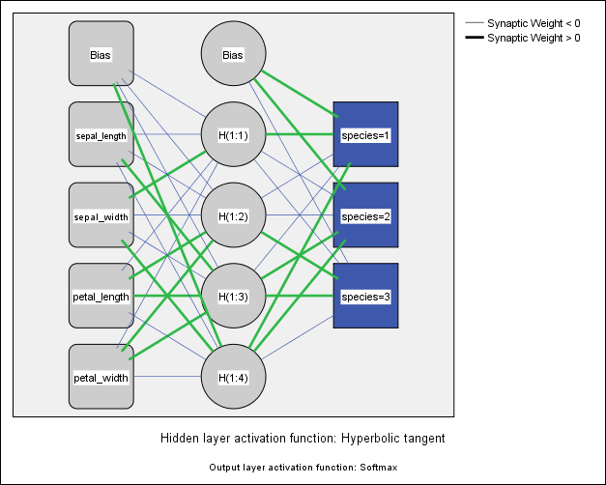
IBM® SPSS® Statistics Neural Networks
What is it?
Helps you model complex relationships between inputs and outputs
When is it needed?
When working with data that has complicated, non-linear relationships
Discover relationships that classical statistical techniques might not find
What’s in it?
Multilayer Perceptron
Radial Basis Function
https://www.youtube.com/watch?v=RU4OzHXF4KQ

Slide 33
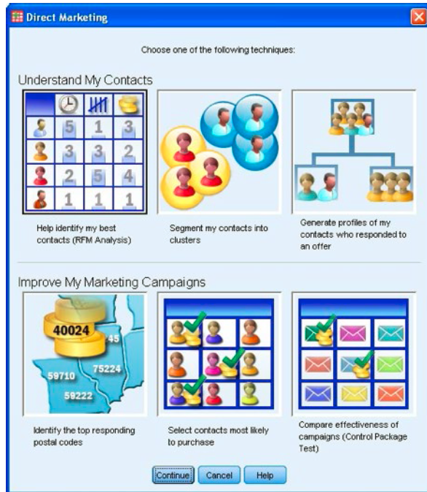
IBM® SPSS® Statistics Direct Marketing
What is it?
Enables you to maximize the ROI of your marketing budget
When is it needed?
When less technical users need to make marketing programs as effective as possible
What’s in it?
RFM analysis based on: Transactional data and Customer data
Propensity to Purchase to determine who is most likely to respond
Generate profiles of contacts
Control Package Test to see which offer works best
Cluster Analysis for segmenting customers
Postal Code Response to identify top postal codes
https://www.youtube.com/watch?v=amXiDf6kn3s

Slide 34
IBM® SPSS® Statistics Complex Samples
What is it?
Helps you achieve more precise analytical results when working with large-scale surveys or complex sample designs
When is it needed?
When working with data not arising from simple random sampling, for example, in survey and market research, social sciences and public opinion research
What’s in it?
Complex Samples Plan
Complex Samples Selection procedure
Complex Samples Descriptives
Complex Samples Tabulate
Complex Samples Logistic Regression
Complex Samples General Linear Models
Complex Samples Cox Regression
https://www.youtube.com/watch?v=_APhWVIBh3s

Slide 35
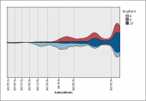
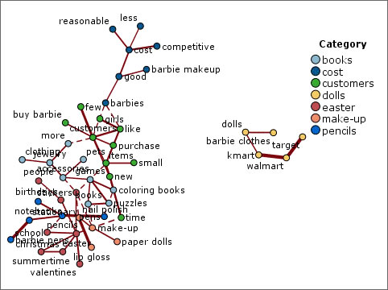
IBM® SPSS® Viz Designer
What is it?
Create compelling templates that can be used in several IBM SPSS software products
When is it needed?
Enabling all users to present results in clear and compelling ways
What’s in it?
“Drag-and-drop" graph creation
Built-in templates
Use style sheets and graph templates
tailored to your organization

Slide 36
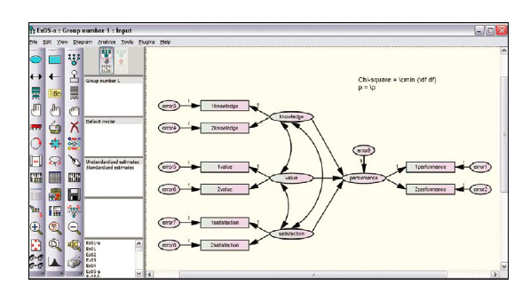
IBM® SPSS® Amos
What is it?
An easy-to-use structural equation modeling (SEM) tool
When is it needed?
When you need to go beyond standard analytical methods, such as regression, factor analysis, correction and analysis of variance
When comparing multiple groups or analyzing longitudinal data
When research includes unobserved (latent) variables in an analysis
What will it help me address?
Study relationships and test hypotheses- find out which variables affect each other and by how much
Testing complex relationships - any numeric variable, observed or not, can be used to predict any other variable

Slide 37
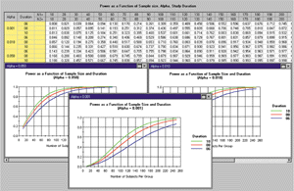
IBM® SPSS® Sample Power
What is it?
Helps you identify the appropriate sample size for your research
When is it needed?
When unsure of the appropriate sample size that will allow you to confidently accept or reject your hypothesis and defend your analysis
When power analysis is required, for example, with many grant applications
What will it help me address?
Easily find the appropriate sample size
See how your sample size will affect statistical power
Compare scenarios before you start your research

Slide 38
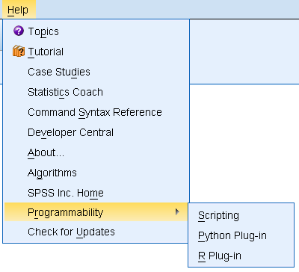
Programmability and Scripting: IBM SPSS Statistics embeds three programming languages
Plug-ins let you extend Statistics capabilities using:
Python
R
.NET languages (Windows only)
Java
Free plug-in downloads
Use existing materials without learning programmability
Create your own programs if you do learn programmability

Slide 39
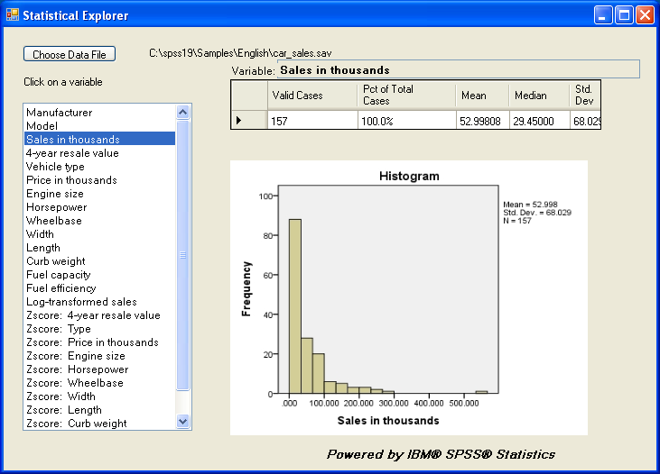
Custom interface built with .NET plugin
Two
pages
of VB.NET
code

Slide 40
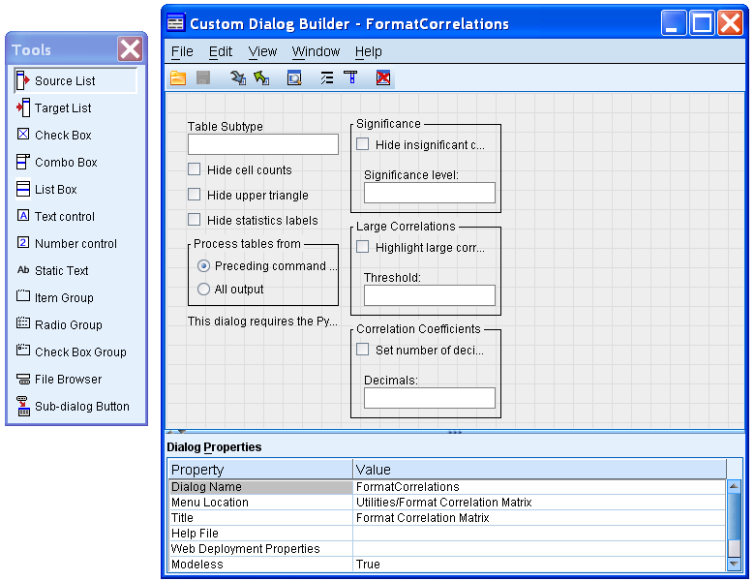
Custom dialog boxes can be easily created to provide user interface for Python or R programs
No programming required
Can be built very quickly
Custom Dialog Builder included with Statistics
Can be used for new extensions or for existing commands
Easy to package and install
Custom dialogs work in IBM SPSS Modeler and IBM SPSS C&DS
If Statistics is installed custom functionality can be used within Modeler

Slide 41
Illustration
Notes:
The objective is to manipulate IBM SPSS Statistics base capabilities: Data Access, Data Transformation, Data Visualization, Statistical techniques
Import the « Bank.xls » data (labels from « Bank.sav » file; Income variables in euros)
Manage the duplicate values of the « City » variable
Create the new « Region » variable
Create the new « Civility » variable from the « Insee » variable (first character: 1=male; 2=female)
Aggregate data by Region
Merge the current data with data from the surve « Survey.xls »
Calculate the age, then display the pyramid of ages
Explain the Income variable

Slide 42
Thank You
Yann Gouedo
Data Scientist Leader – Machine Learning / Artificial Intelligence
Marketing / Risk / Fraud / Maintenance
IBM Certified Senior Data Scientist & IBM Certified Senior Architect

